Slide 1
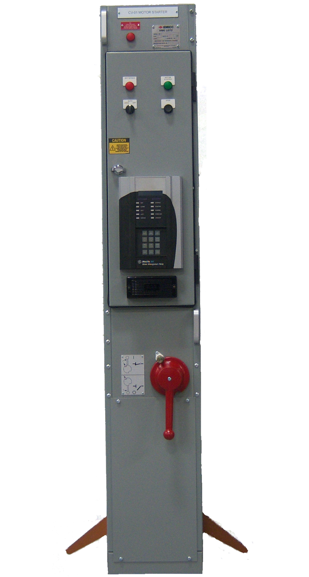
EMICC
ELECTRIC MACHINERY INDUSTRIAL CONTROLS CORPORATION
Refurbishment
Program
504 Valley Dr. Perry, GA. 31069
PH. 478-987-3003
WWW.NEWEMICC.COM

Slide 2

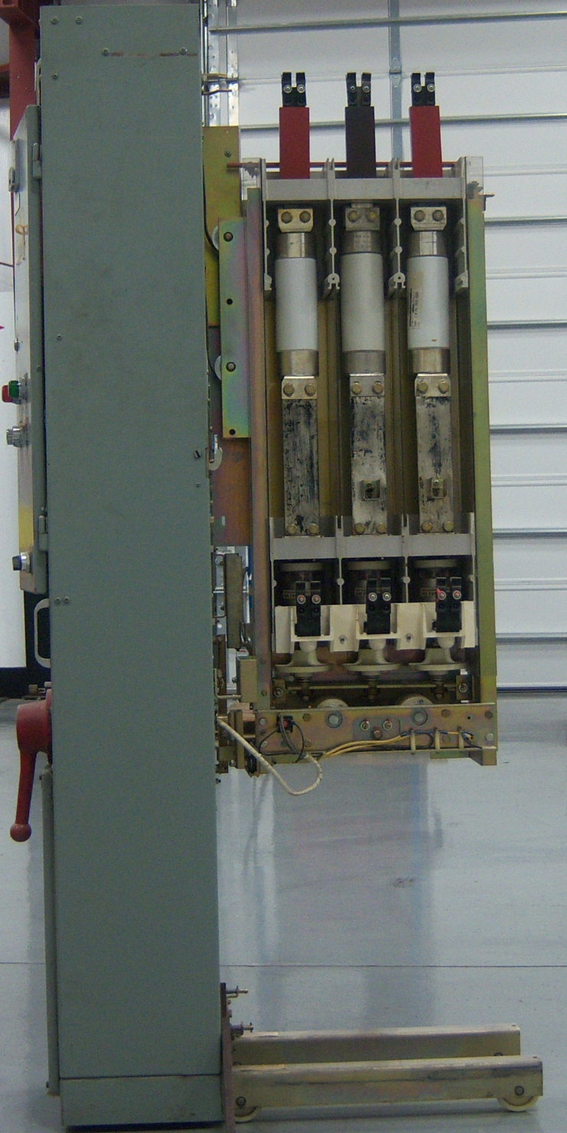
Most starters were manufactured over 25 years ago. The fact that these starters still operate trouble free is attributed to the rugged design of the equipment. However, you can’t expect for the equipment to run forever so it will be a matter of time before an unexpected outage happens.
EMICC highly recommends a factory recondition of the withdrawable section of the starter (truck).
This design, although modernized, is still manufactured by EMICC in Perry, Georgia.

Slide 3
Replacement of all major power components
Replacement of vacuum switches.

Slide 4
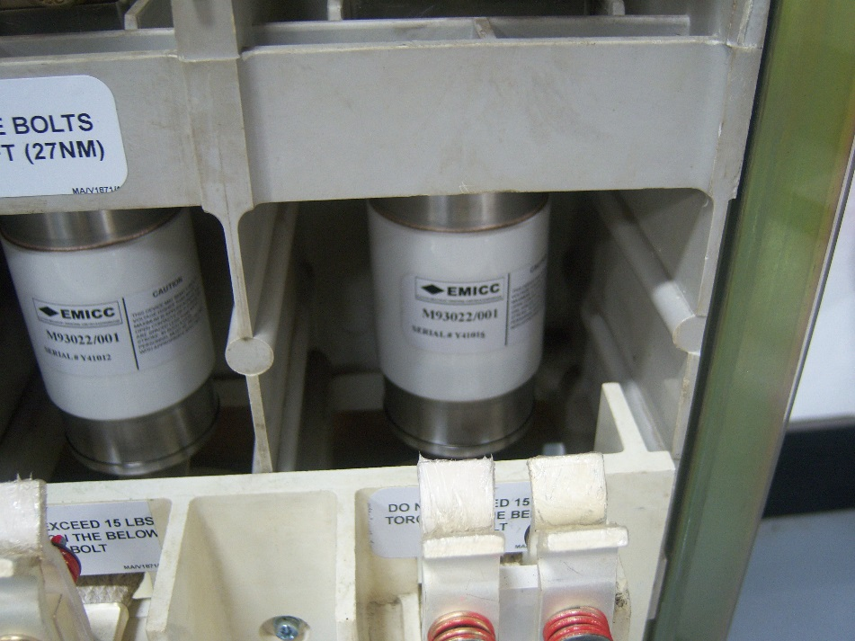
Replacement of vacuum switches
Vacuum switches will be replaced with ceramic VSM5 or VSM6. These switches are rated 400A (VSM5) and 600A (VSM6), with a mechanical and electrical life of 1,000,000 operations.

Slide 5
Replacement of all major power components
Replacement of uniball bearings.
Replacement of armature stop pad.

Slide 6
Replacement of all major power components
Rebuild caliper assemblies with new springs.
Replacement of closing coils.

Slide 7
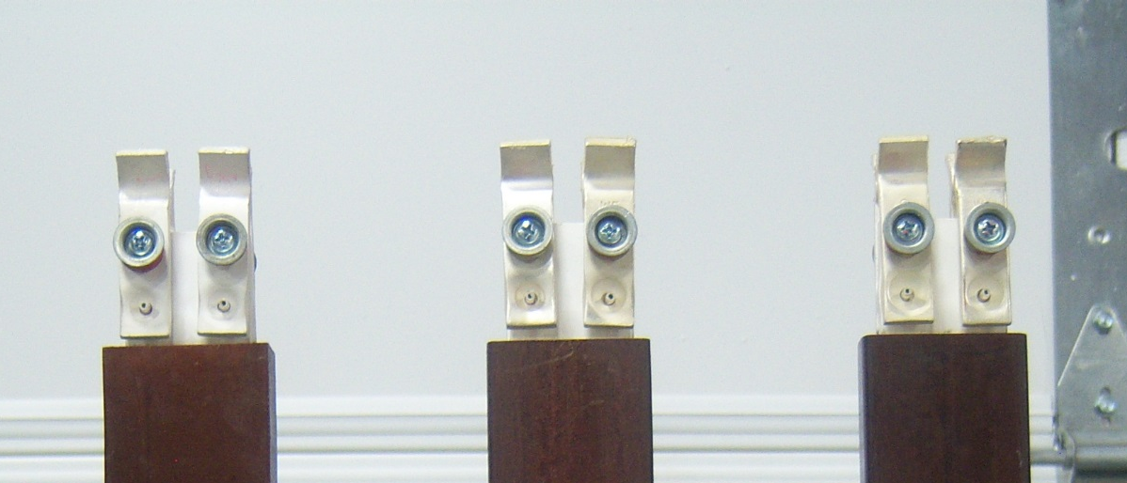
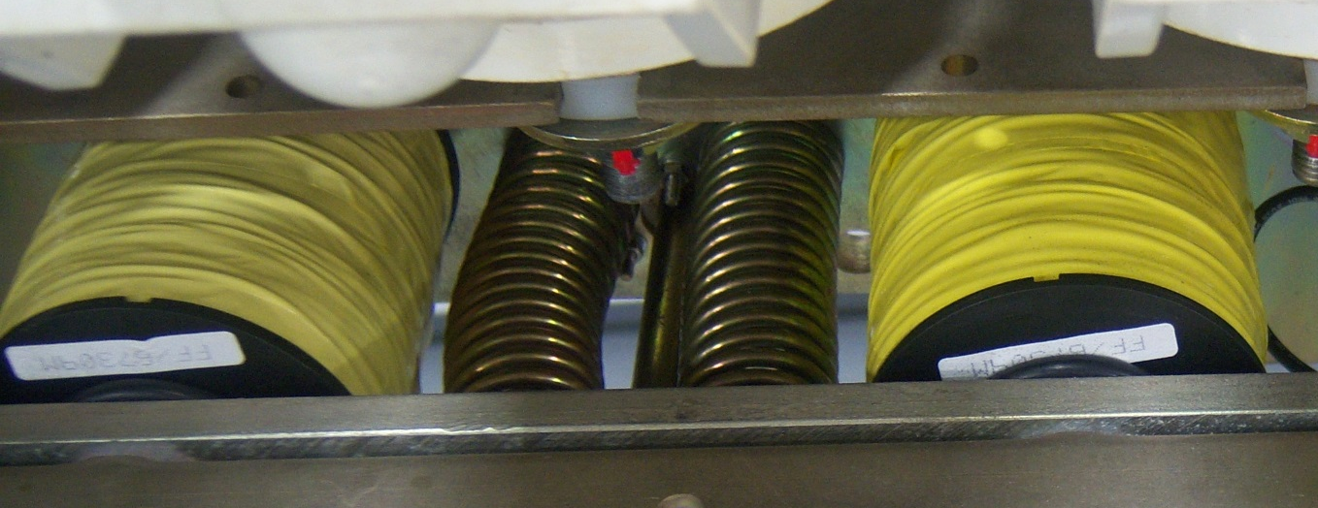
Rebuild caliper assemblies
All calipers will be rebuilt with new springs and hardware.
Replacement of closing coils
Both closing coils will be replaced with new coils and washers.

Slide 8
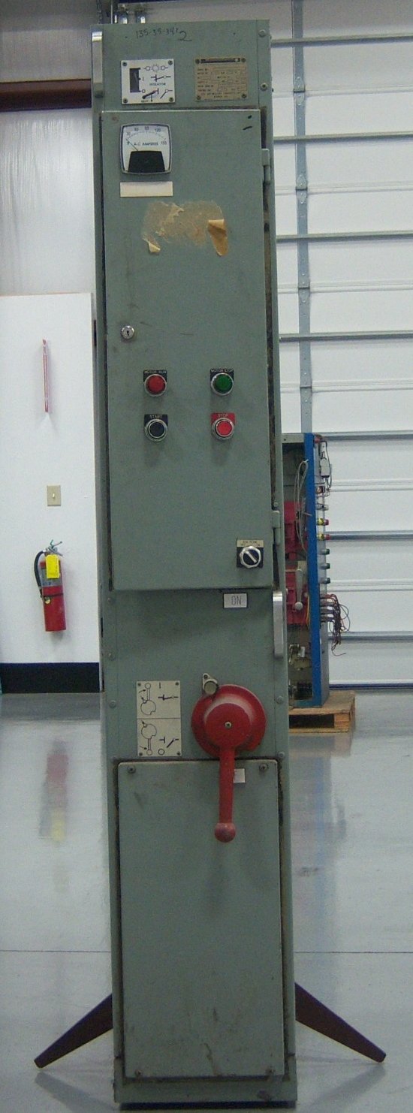
Cosmetics upgrades and repairs
Upgrade mechanical blown fuse indicator to new LED indication
Replace truck box, base and isolator plate (in lieu of sand and repaint)
Upgrade pilot devices
Replacement of gasket on doors and covers.
Replacement of push button bearings
Bottom cover replace with flat panel
(no more pinched fingers)

Slide 9
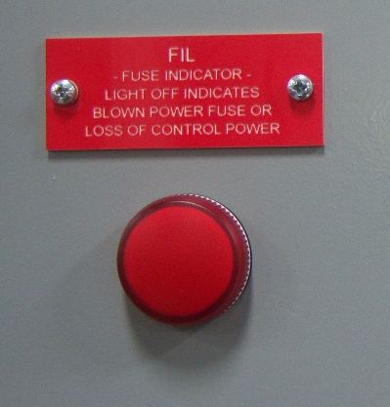
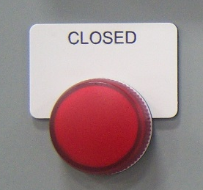
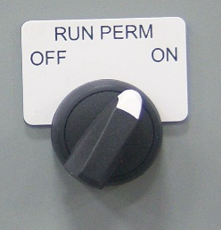

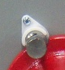
Upgrade blown fuse indicator
The mechanical blown fuse indicator will be replaced with a LED indicator.
Upgrade pilot devices
All lights, switches and buttons will be updated with more current devices and LEDs.
Replacement of pushbutton bearing
The IPB bearing will be replaced with a new bearing.

Slide 10
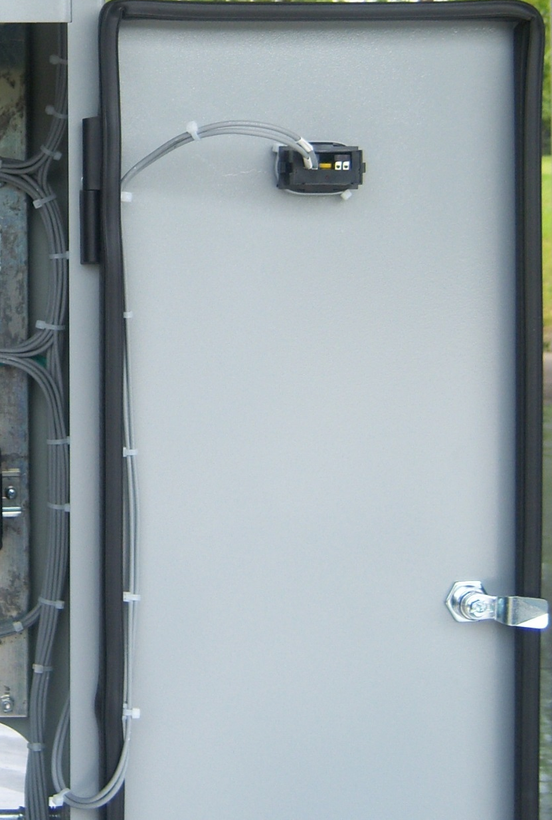
Replacement of gasket
The gasket will be replaced on the door and panel with NEMA 12 rated gasket.

Slide 11
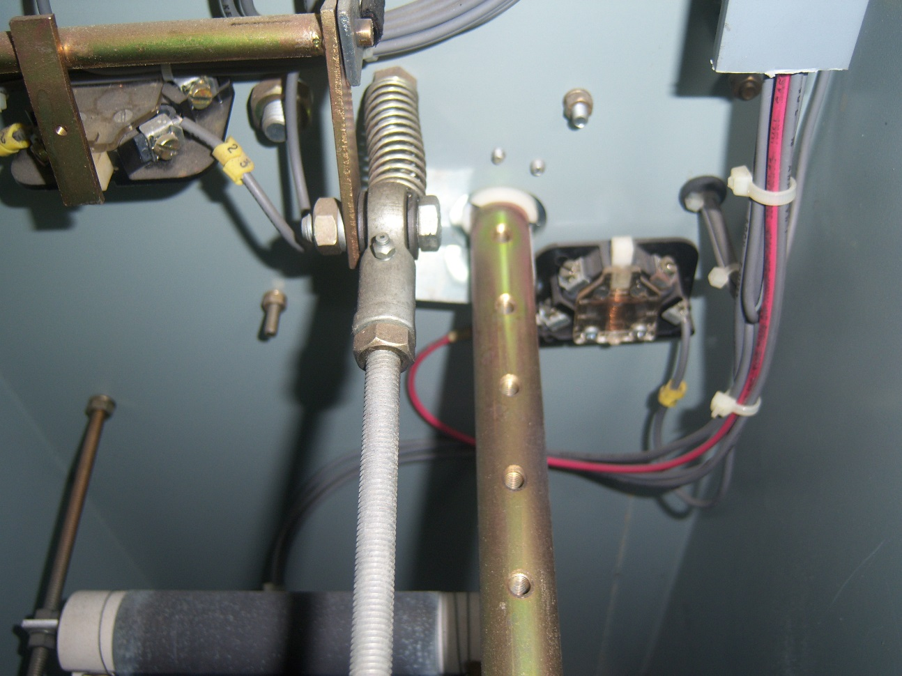
Replacement of interior components
Replacement of isolator shaft bearings
Upgrade of safety switches
Upgrade of economizing resistor

Slide 12
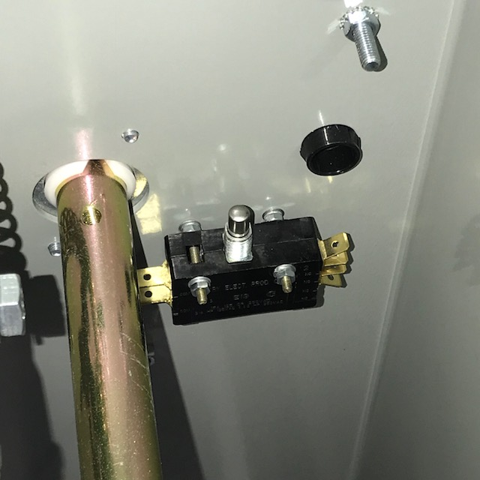
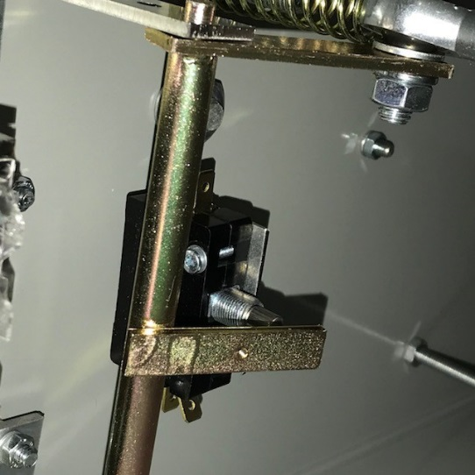
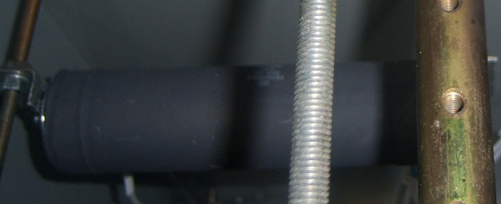
Replacement of isolator shaft bearing
The isolator shaft bearing will be replace with a new bearing.
Upgrade of safety switches
Both the IPB and ISS switches will be upgraded.
Replacement of economizing resistor
The economizing resistor will be upgraded to a new resistor.

Slide 13
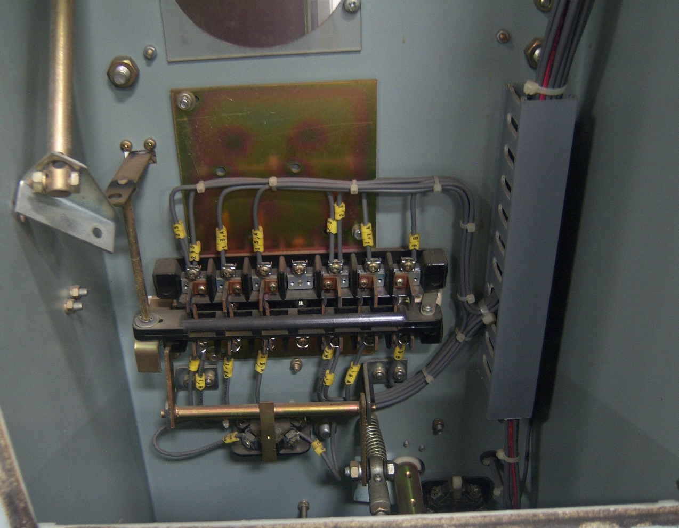
Replacement of interior components
Upgrade of RC contact blocks.

Slide 14
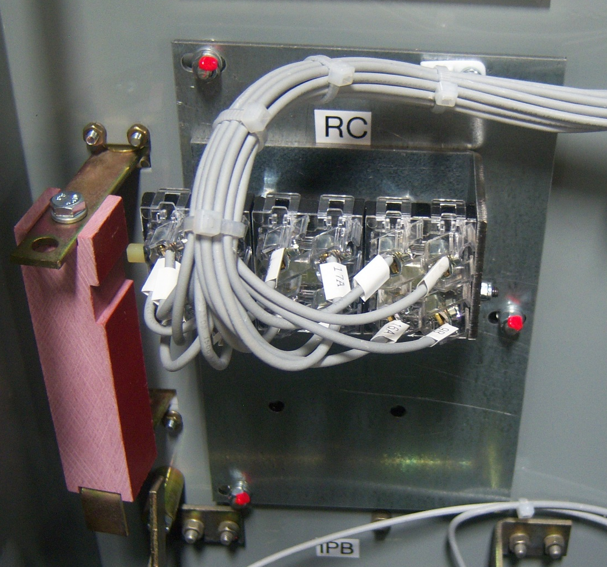
Upgrade of RC contact block
The old open style contact blocks will be upgraded to a new enclosed style contact blocks.

Slide 15
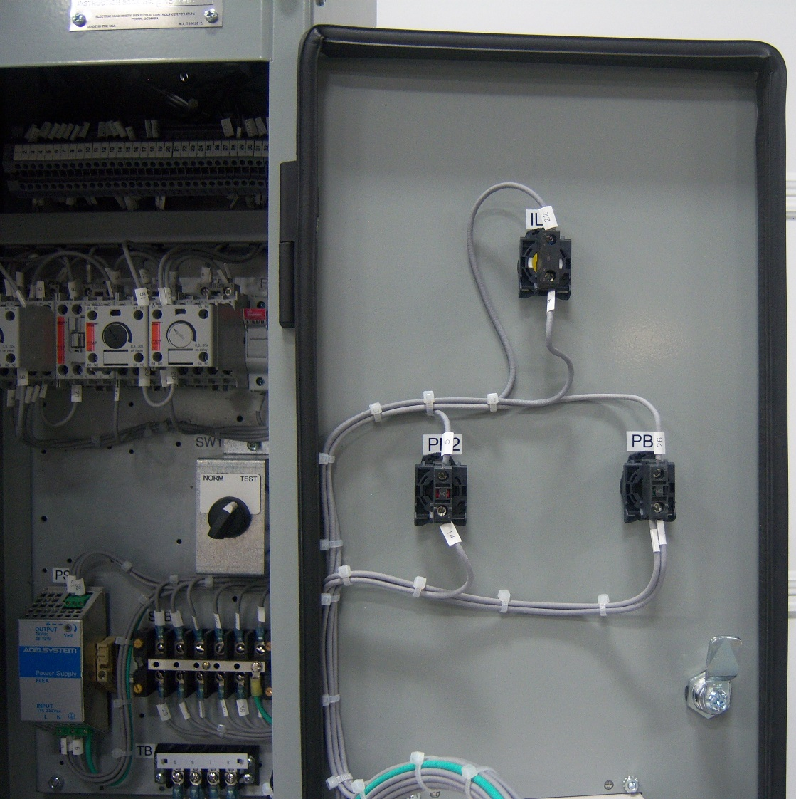
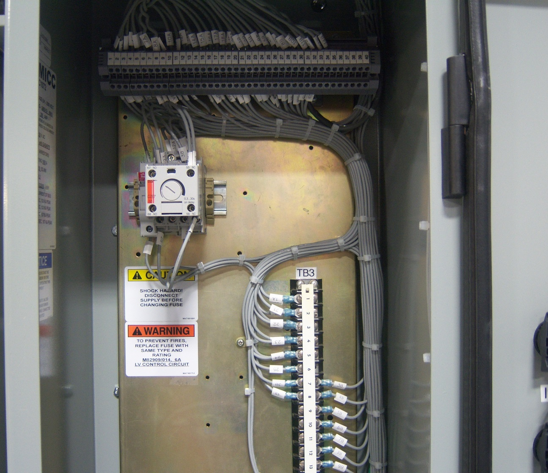
Interface Terminal Block
Interface terminal block used from old socket wiring. New wiring and control components installed.

Slide 16
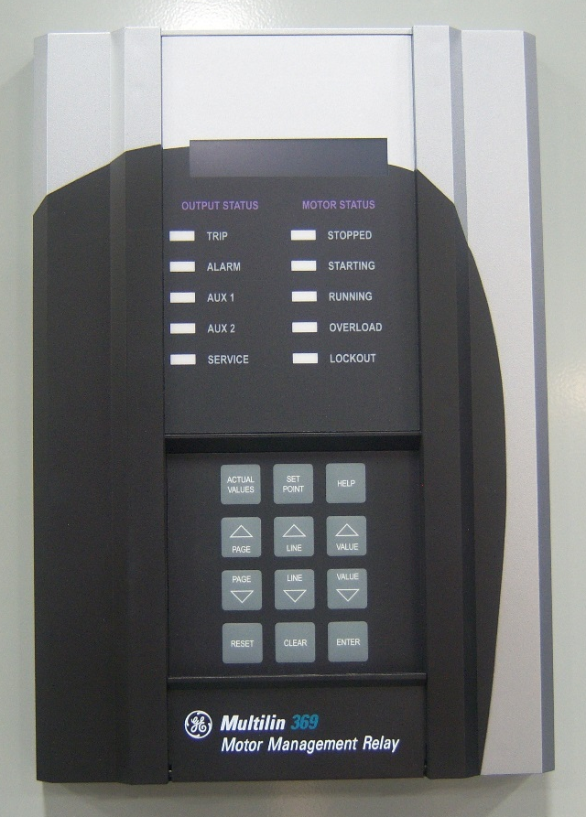
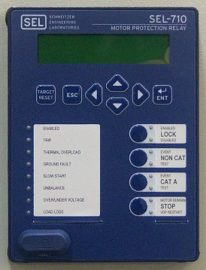
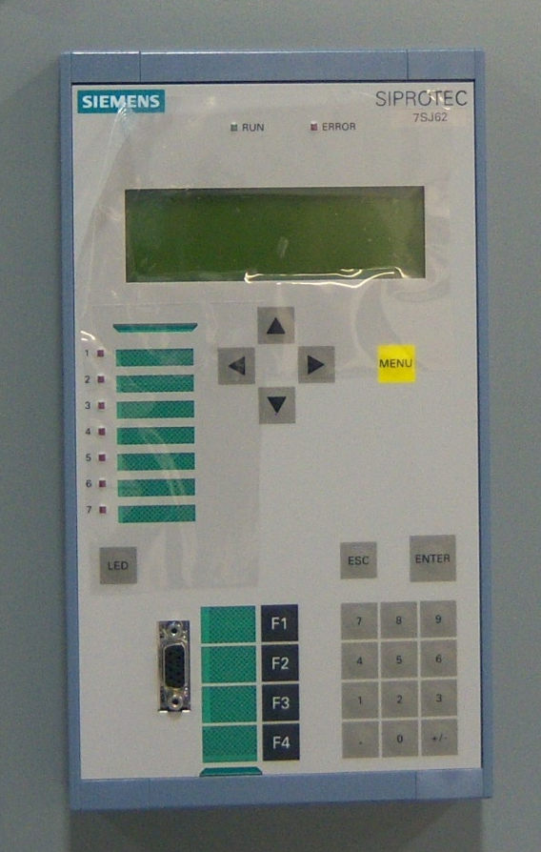
Many customer Projects include upgrade of motor protection. EMICC has incorporated most every style protection relays such as GE/Multilin , Schweitzer, Siemens, Eaton and others. Most customers upgrade projects are done with a minimal engineering cost.

Slide 17
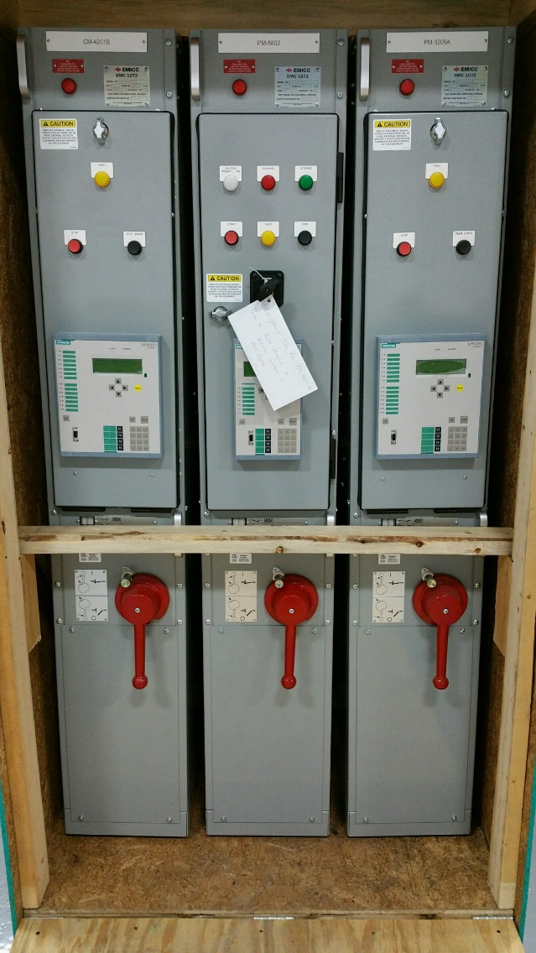
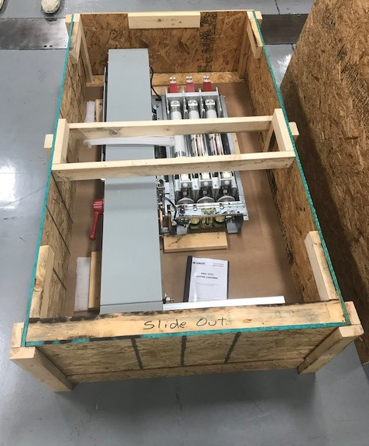
Shipping of new units
A crate can be built and shipped to you for shipping of the units that you will want to have refurbished.
Units can be shipped in a stand up crate that will hold any combination of up to 3 starters.
Units can also be shipped lying down in a crate that will only hold 1 starter.

